Slide 1
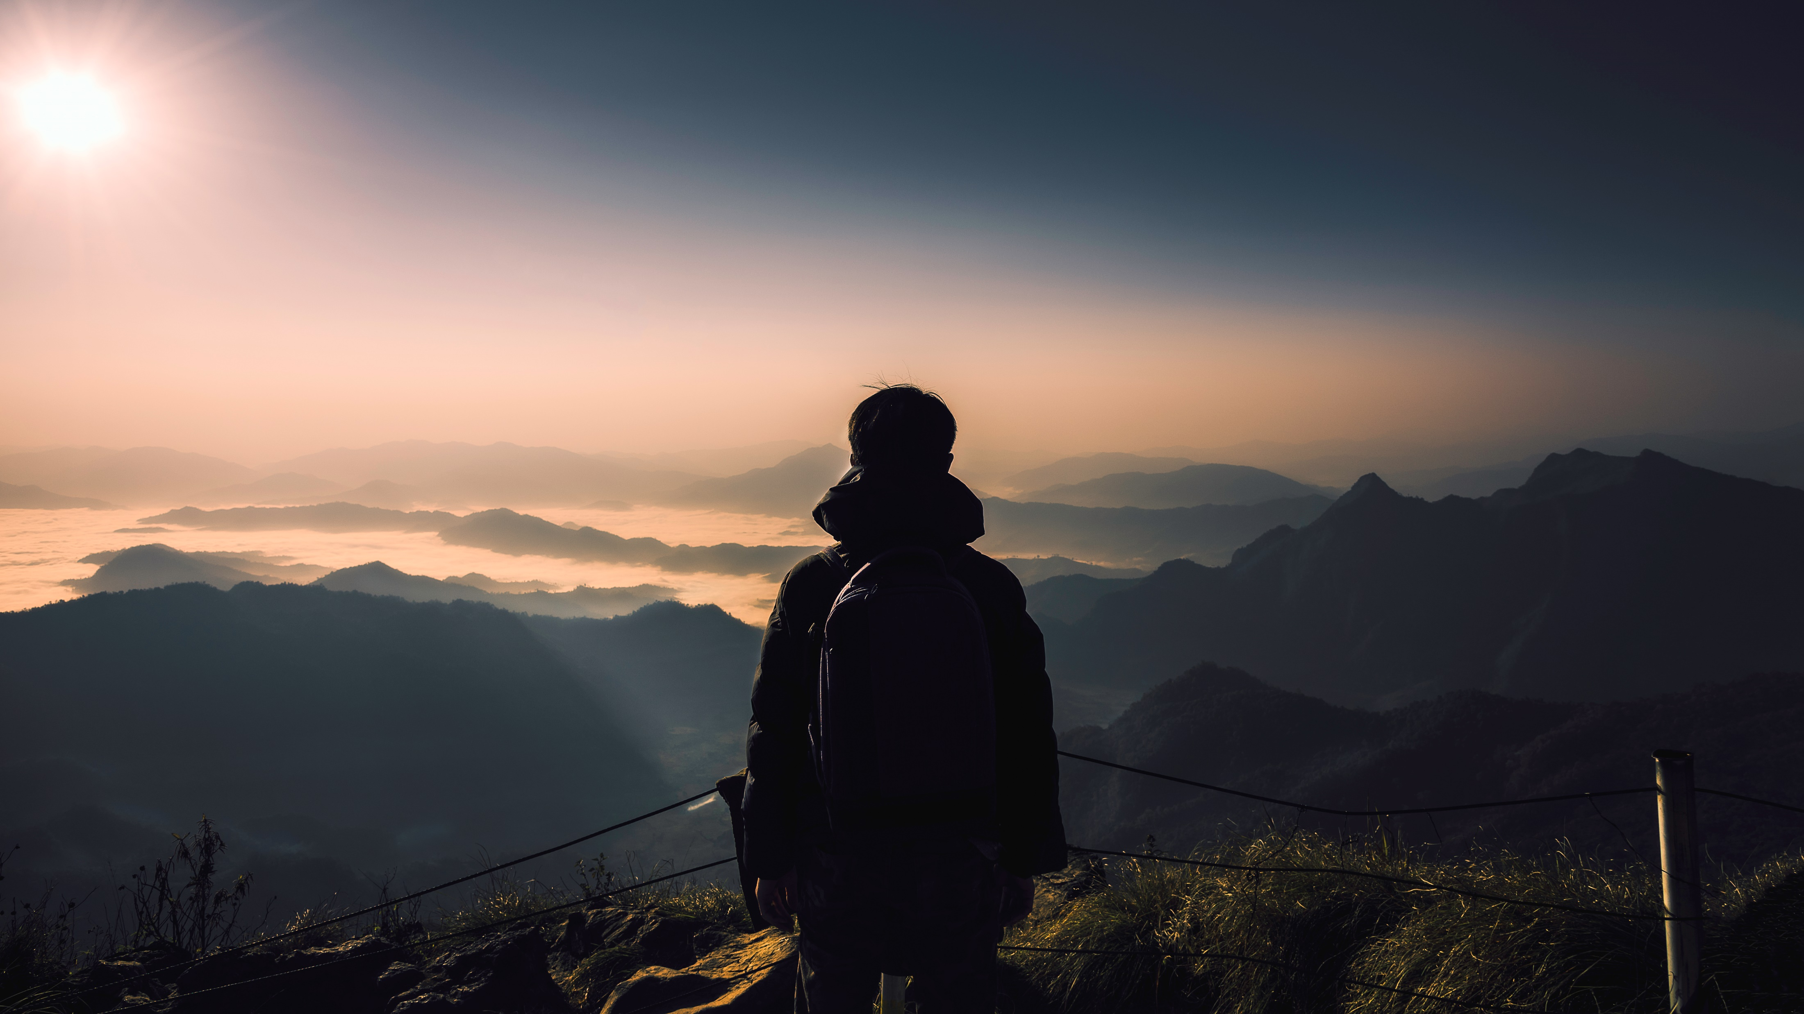
ROUTE MAPPING PROBLEM & DRINK AND DRIVE EVALUATOR
Let’s Travel SMART and SAFE

Slide 2
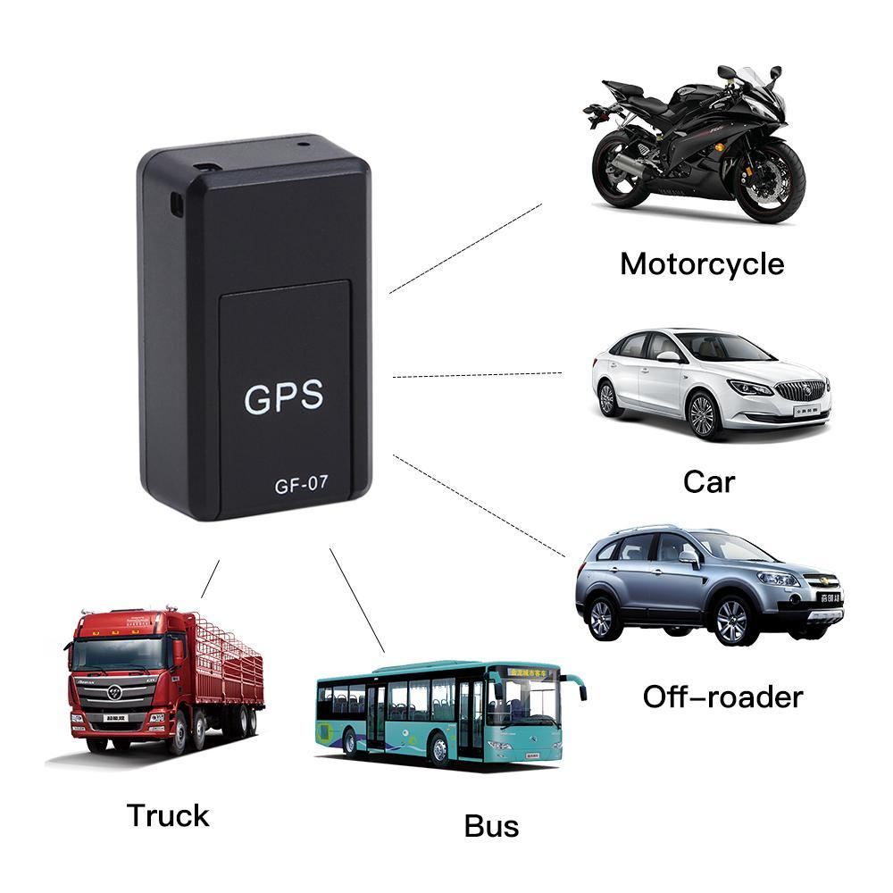
PROBLEm of Route mapping in local Transport
Travelers and Non-residents face a lot of problems while travelling from one point to another , They have only one option left and that is CAB , Which is neither Cost Efficient nor Environment Friendly. So they prefer local buses which is also not possible as they also don’t know their location and from where to catch them?

Slide 3
SOLUTION OF LOCATING LOCAL TRANSPORT
The TRACKER that we are making and trying to install in the Local Transport would display it’s route on the screen and would also tell us the correct position of the local transport I which we want to travel.

Slide 4
PROBLEM OF WRONG NAMES ON GOOGLE MAP
Nowadays, We all face a problem of getting Wrong names on google map and get confused if we are,
Non-resident or a tourist so it is very necessary to get correct names so that we can reach the destined
Place.

Slide 5
DRINK AND Drive evaluator
Nowadays , There are a lot of accidents happening due to drink and drive by the driver . The driver does not care of his as well as the passengers that he/she has the responsibility of.

Slide 6
Solution-DND EVALUATOR IS PROVIDING
Our DND Evaluator is providing a very innovative way to prevent accidents due to DRINKING and DRIVING .
We will install our setup on the steering of the local transport and as soon as there is alcohol in the air the engine of the vehichle will cease and there would be a notification to the nearest police station or local traffic police telling them the vehichle’s location and tell them to approach the vehichle as soon as possible.

